Slide 1
Research Plan
By Group 3
Emilia Hansen
Roos van der Weij
Stella Marban
Emma van der Hoofd
And Joshua Gabriel Belong Suva

Slide 2
Table of Contents
Problem Analysis
Problem Definition
Main Question
Objective
Sub-Questions
Research Methods
Background
Client

Slide 3

Problem Analysis

Slide 4
Background
Who – Guests, Staff and External Partners
What – Inconsistent event management process on all locations of Hanze
Where – Wiebenga Building
Why – The aging building lacks space and accessibility
How – Identifying opportunities

Slide 5
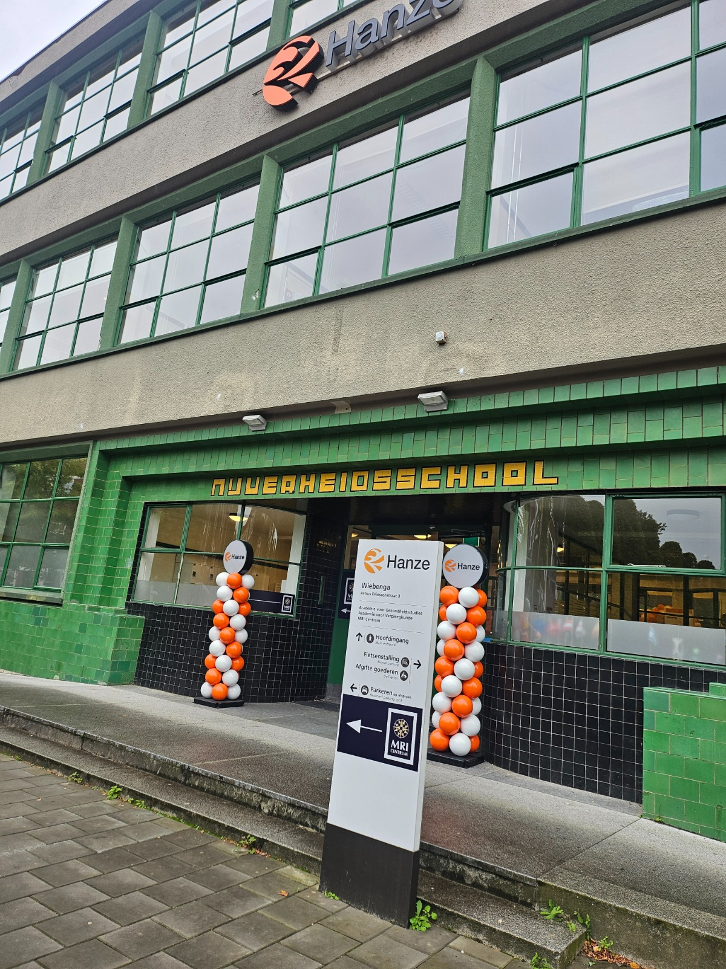
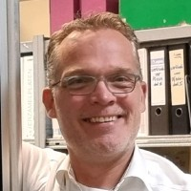

Client
Hanze University
Wiebenga
Ruud De Lange

Slide 6
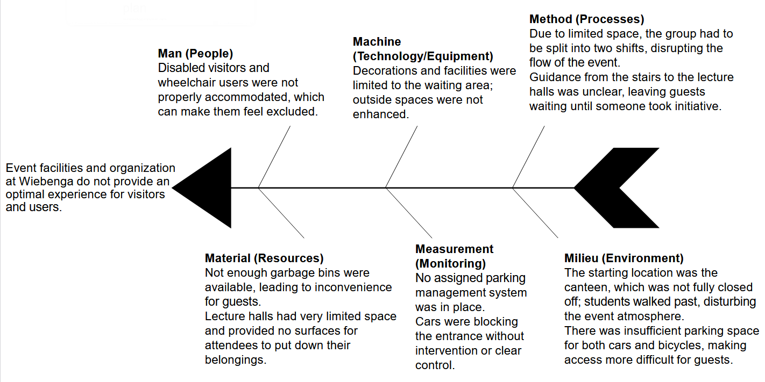
Ishikawa

Slide 7
Problem Definition
The lack of a standard event process across the healthy aging cluster in the Hanze University lead to inconsistent event experiences for users, guests and staff.

Slide 8
Research Questions

Slide 9
Main Question
What needs to change to streamline the event management process at Wiebenga to be more aligned with the campus event organization?

Slide 10
Sub-Questions
What is the current event process in Wiebenga?
What type of bottle necks are the most common?
What are the differences between the event process on the campus and Wiebenga?
What can be done to improve the user and staff experience?

Slide 11
Objective
Research Objective Analyze Wiebenga's event process to identify differences, strengths and opportunities. Afterwards, provide actionable recommendations for Wiebenga and Hanze that are backed by data and facts.
External Objective Improving both the consistency and the overall event experiences of users, staff and guests within Hanze University.
Internal Objective Align Wiebenga's event process with the other locations.

Slide 12
Methods of Research
Survey
Interview
Ishikawa and 6Ws
Event Request
Observation

Slide 13
Survey Questions
1. Have you ever attended an event at Wiebenga? (Open days count as well)
2. How would you describe the overall atmosphere at the event?
3. How easy was it for you to locate the venue? (1-5)
4. Was the event venue accessible for individuals with disabilities?
5. How difficult was it to find parking space? (1-5)
6. How easy was it to dispose your garbage? (1-5)
7. How would you rate your overall experience at the event?
8. If you could suggest one improvement for future events, what would it be and why?

Slide 14

Questions?

